Slide 1



MLOps IMPLEMENTATION ON AZURE FOR REAL-WORLD DATA SCIENCE Use Case (Cross-selling in Insurance Industry)
A Presentation of MSc Dissertation
Patricia Inyang
Mirjam Nilsson​
January 29th, 2024

Slide 2


Content
Introduction
Project Objectives
Methodology
Results
Project limitations
Recommendations
Lessons Learnt
Appreciation

Slide 3
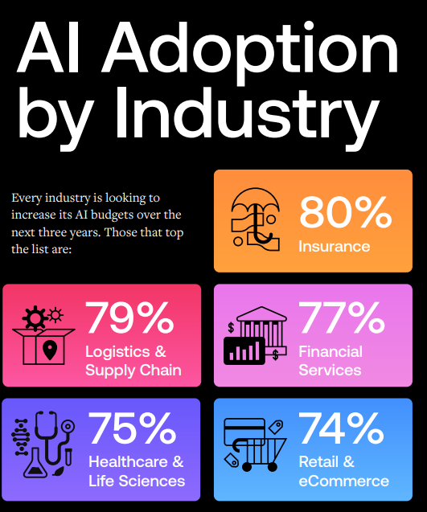
Introduction
Technology research firm Gartner, Inc. estimated that 85% of artificial intelligence (AI) and machine learning (ML) projects fail to produce a return for the business.¹
Only around 13% of data science projects ever make it into production.²
Azure machine learning (AML) offers a Platform as a service (PaaS) for streamlining MLOps end-to-end solution.
Cross-selling is a sales strategy where a business promotes additional products or services to existing customers.
Cross-selling enhances competitive advantage, valuable customer relationship, cost efficiency, and customer retention for Insurers.
2023 AI Readiness Report

Slide 4
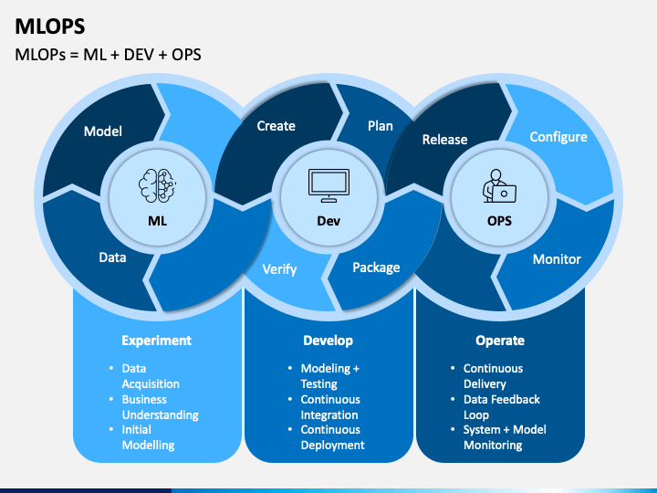
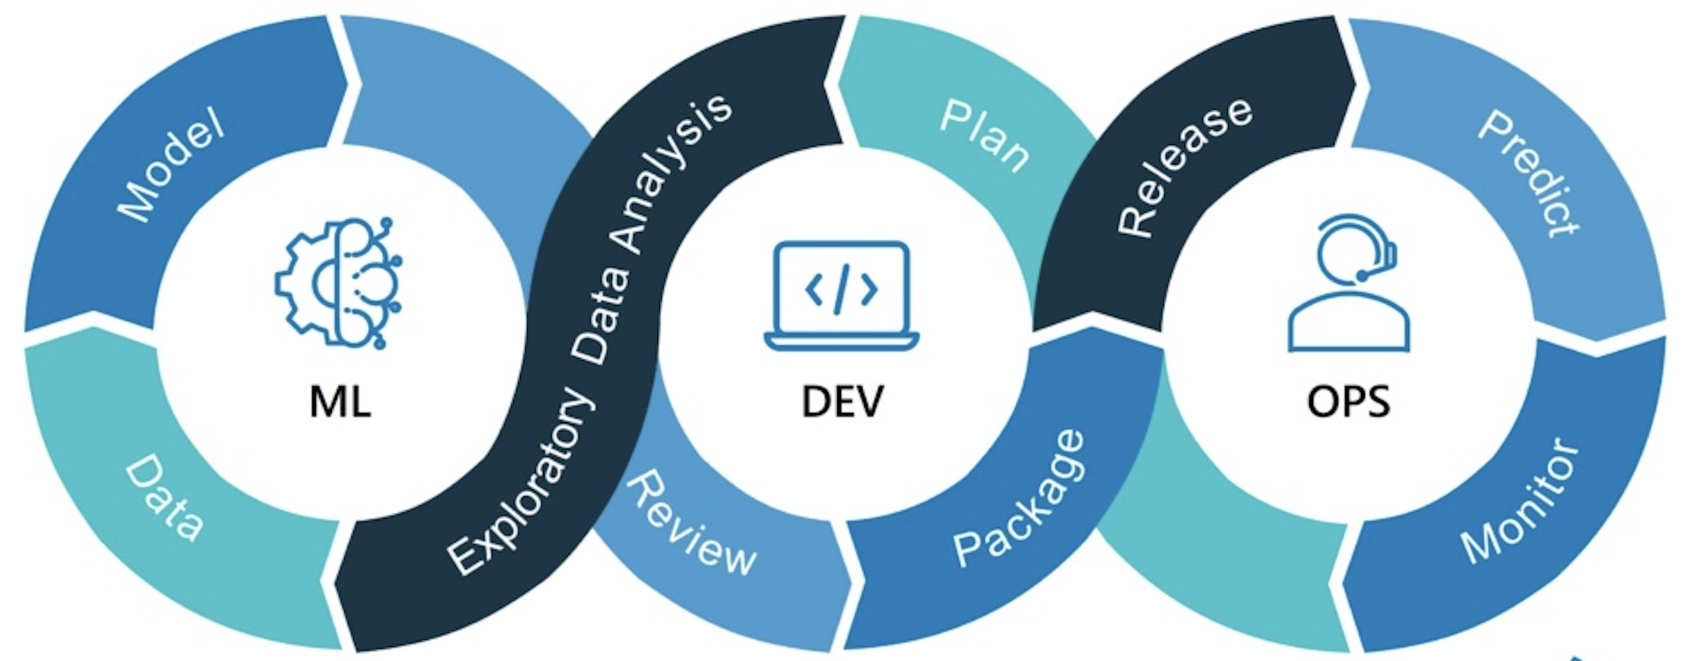
Machine learning Operations (MLOps)
What is MLOps?
MLOps is defined as the culmination of people, processes, practices, and underpinning technologies that automate the development, deployment, monitoring, and management of machine learning (ML) models into production in a scalable and fully governed way to finally provide measurable business value from machine learning.³

Slide 5
Description of the Insurance Cross-selling Data
The specific use case involved the development of a Vehicle Insurance model to predict responses (’Interested’ or ’Not interested’) of existing health insurance policyholders regarding newly offered vehicle insurance policy.
S/N | Feature name | Feature Description | Type of Feature
1 | Gender | Gender of the customer | Categorical
2 | Age | Age of the customer in years | Continuous
3 | Driving_License | 0 : Customer has no driving license; 1 : Customer already has driving license. | Categorical
4 | Region_Code | Unique code for the region of the customer | Categorical
5 | Previously_Insured | 0 : Customer has no previous vehicle Insurance; 1 : Customer already has vehicle Insurance. | Categorical
6 | Vehicle_Age | Age of the Vehicle | Ordinal categorical
7 | Vehicle_Damage | 0 (no) : Customer vehicle did not get damaged in the past; 1 (yes): Customer vehicle got damaged in the past. | Categorical
8 | Annual_Premium | The amount customer needs to pay as premium in the year. | Continuous
9 | Policy_Sales_Channel | Code for the channels used to reach the customers. | Categorical
10 | Vintage | Number of Days, Customer has been associated with the company. | Continuous
11 | Response | 0 : Customer is not interested in Vehicle Insurance 1 : Customer is interested in Vehicle Insurance | Binary (target variable)

Slide 6
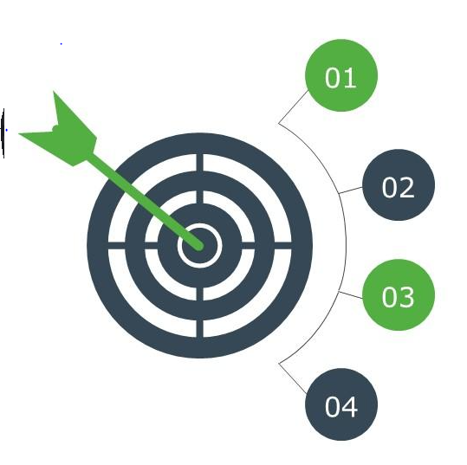
Project Objectives
To successfully Implement MLOps in Azure, advancing through the MLOps maturity levels.
Close the business value gap in ML models
Transit from development to deployment of the cross-selling ML model to production.
Surmount MLOps Implementation Challenges
Infrastructure, expertise, reproducibility, scalability.
Governance Considerations
Responsible AI solution, providing accountability, audit trail logs and transparency throughout the model's lifecycle.
Sustain Optimal Model Performance
Automate retraining, redeployment and seamless integration of continuous improvements.

Slide 7
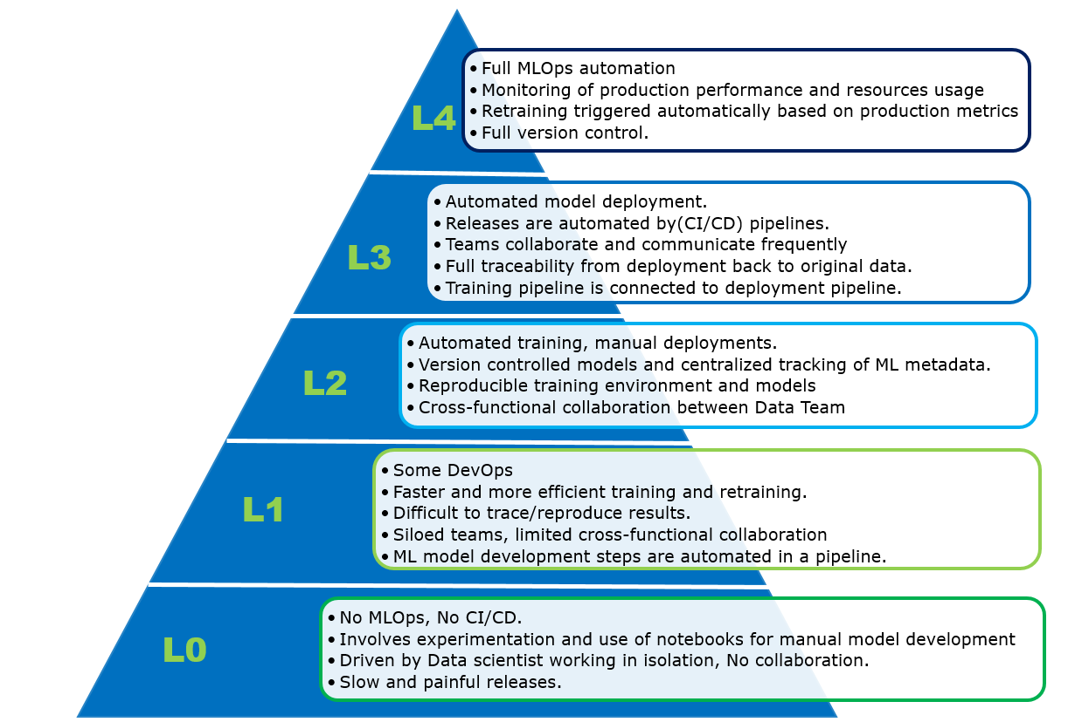
MLOps Maturity Levels

Slide 8
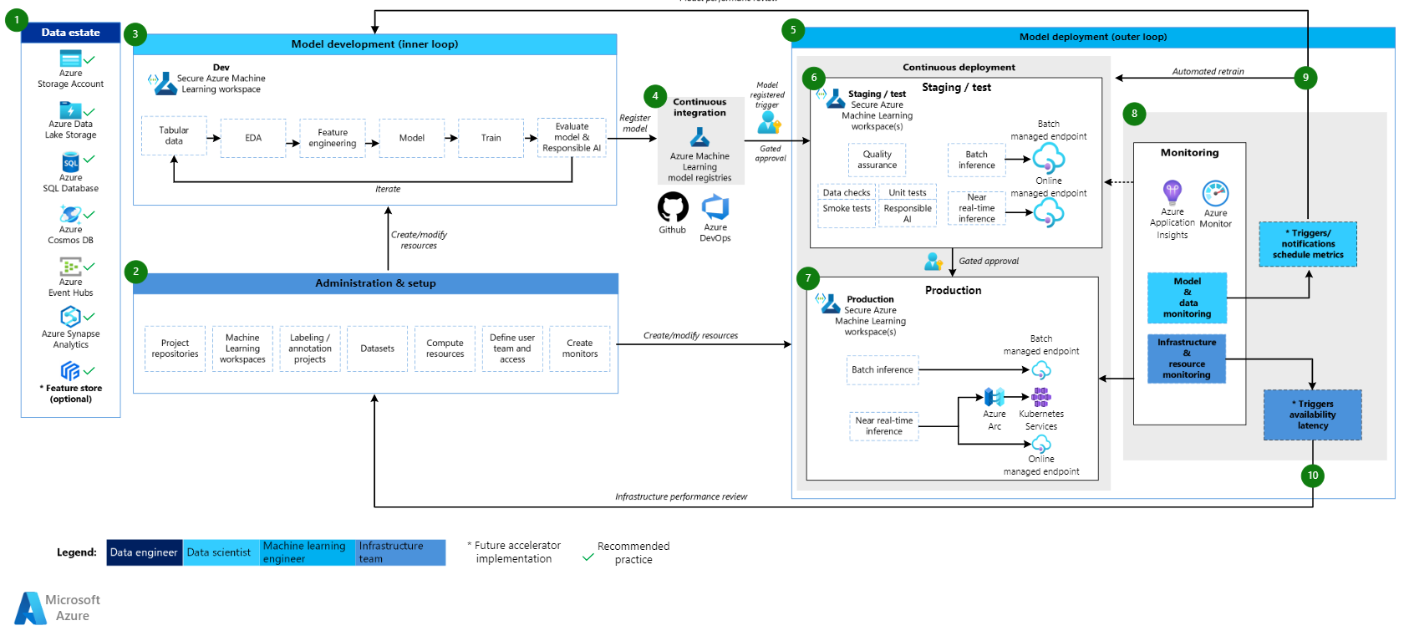
High-level diagram of Azure Recommended MLOps structure
Collaboration
Modularity
Security
Automation
Enterprise readiness

Slide 9




Project Methodology
Azure Machine Learning Python SDK v2, AML command line interface (CLI) and AML Studio were utilized.
The project was executed in four stages
Experimentation
Exploratory data analysis(EDA)
Data preparation
Training and evaluation of classification models
Select model with highest recall
Infrastructure
Configuration
Setup AML workspace and AML Resources
Setup GitHub repository and Continuous Integration pipeline
Prepare scripts
&
build pipelines
Refactoring codes in scripts
Test scripts
Build pipelines to connect ML cycle steps
Test pipelines
Automating the MLOps
Set up production environment with Azure service principal credentials
Automation with GitHub action workflows for pipeline runs in production & CI/CD

Slide 10
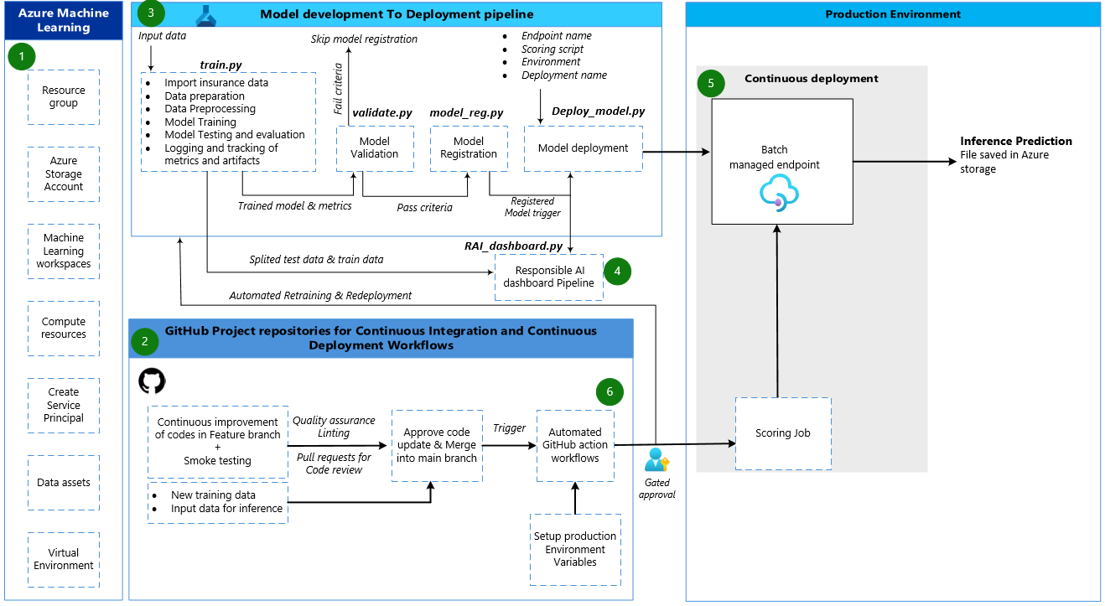
High-level diagram of MLOps implemented in Azure for Vehicle Insurance model

Slide 11

Results

Slide 12
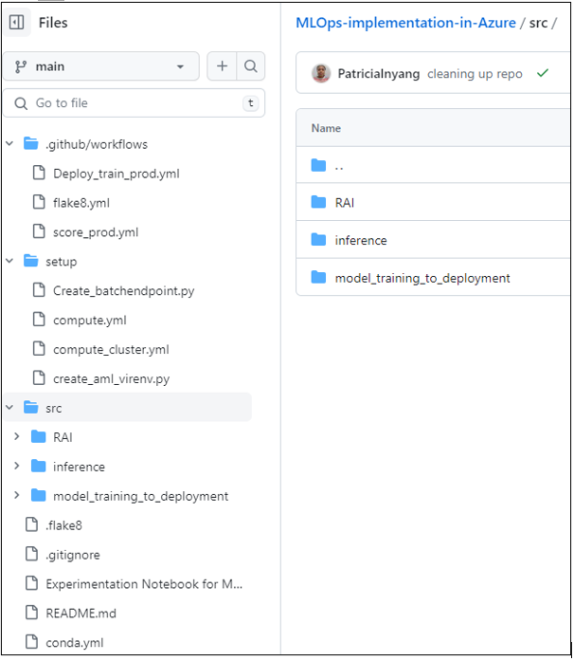
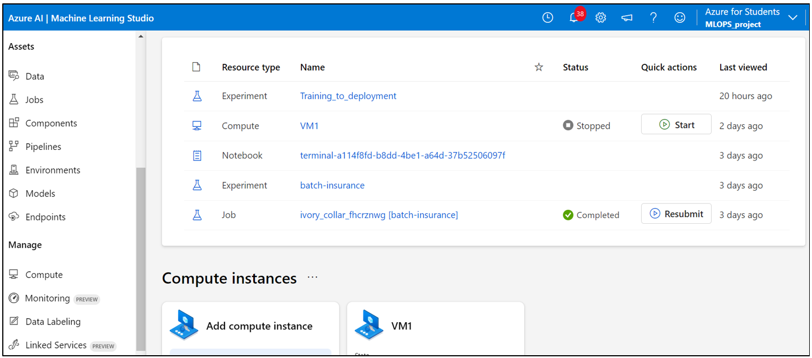
Valuable features of the orchestrated Azure MLOPs
Automation through CT/CI/CD.
Managed services, infrastructures and scalable resources.
Experimental tracking, logging and traceability
Easy Integration with MLFlow, GitHub, and other tools/Azure services
AML Workspace has a user-friendly interface
Reliable and secure through credentials authentication and RBAC
Interactive user friendly RAI insight dashboard
Versioning of models, data and codes
Supports reusable components.

Slide 13
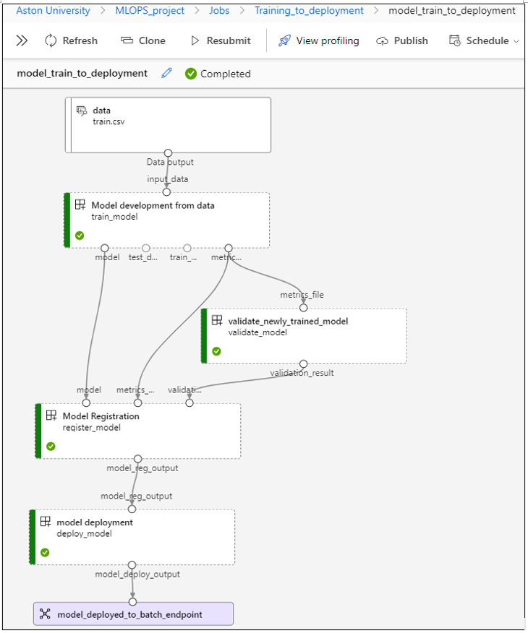
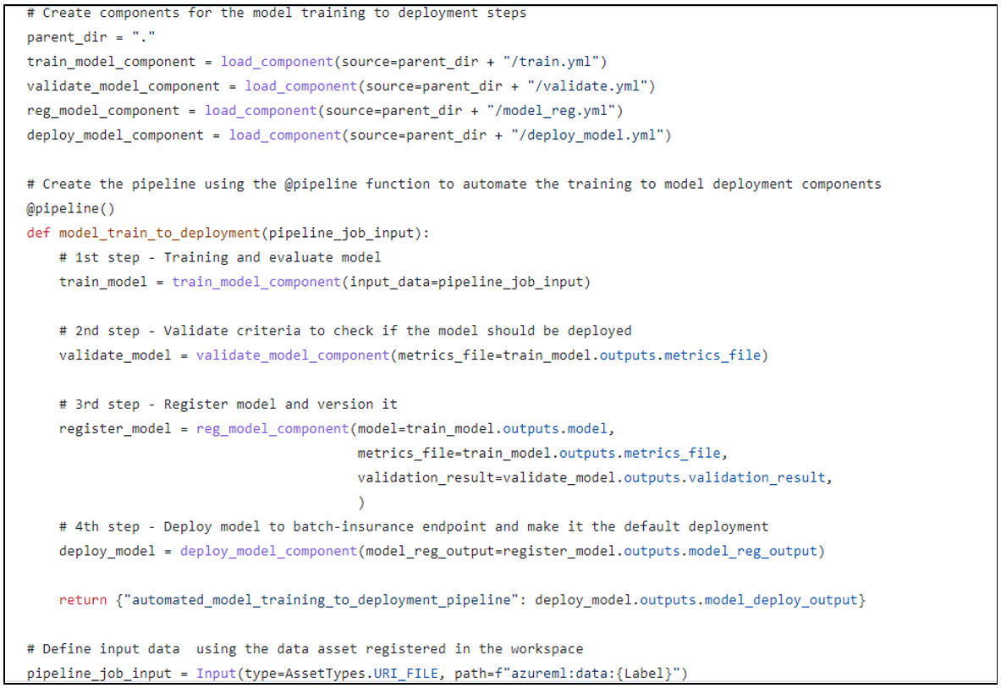
Overview of Model Training to Deployment pipeline

Slide 14
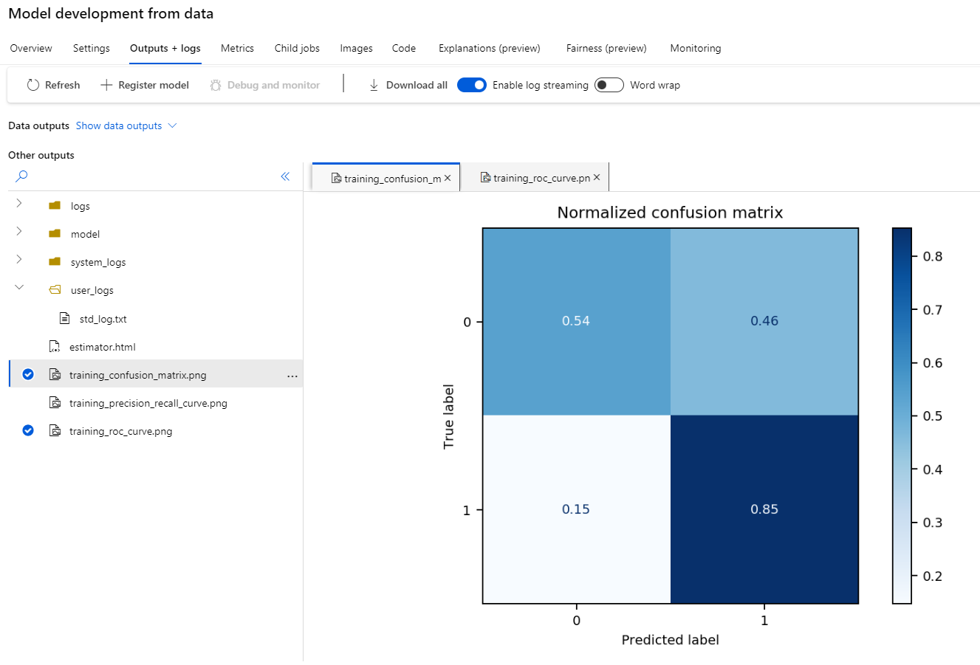
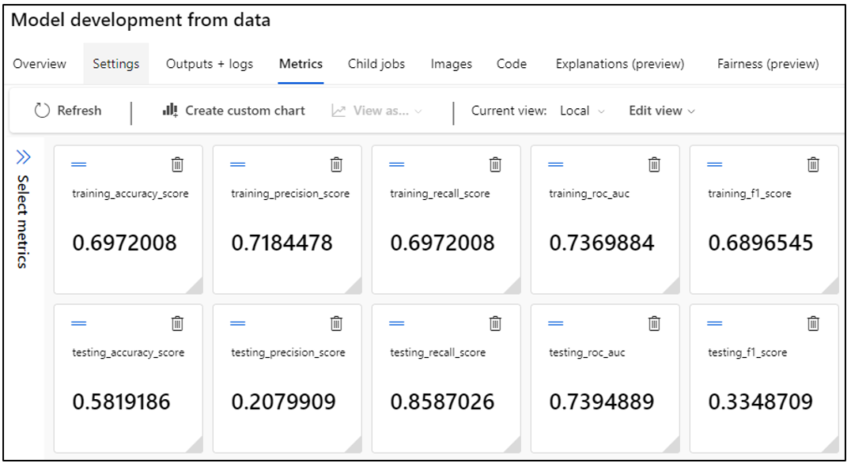
Model Performance Metrics and Artifacts from the Model Training step

Slide 15
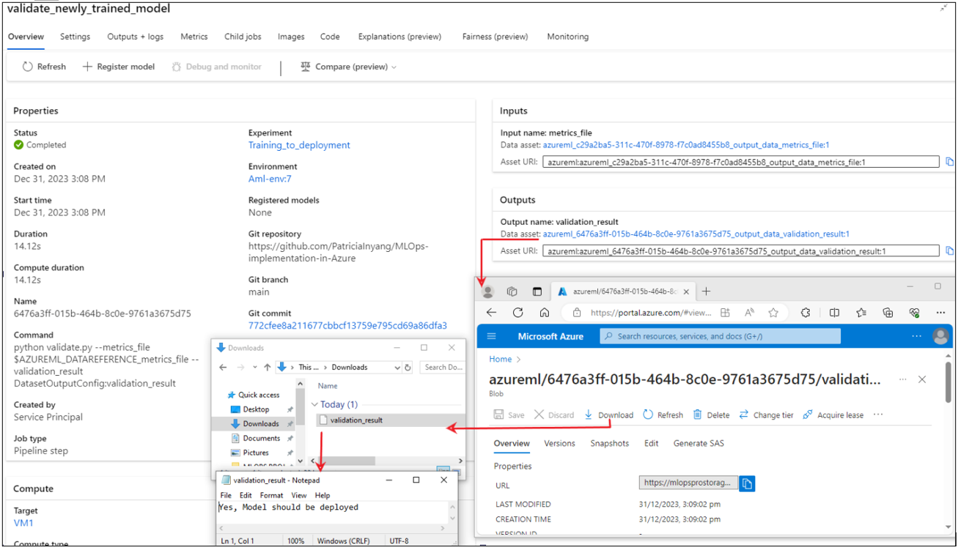
Results of from the Model Validation step

Slide 16
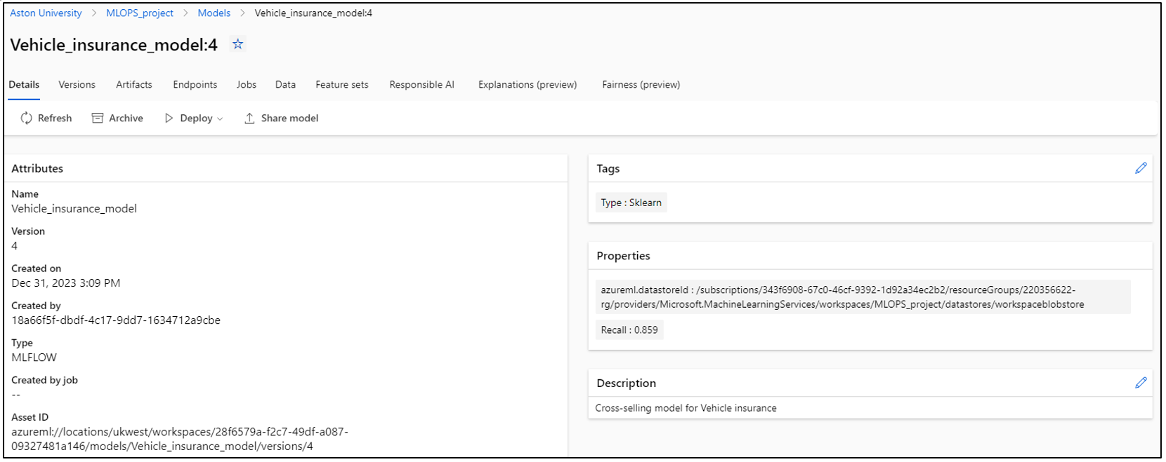
Result of the Model Registration Step

Slide 17
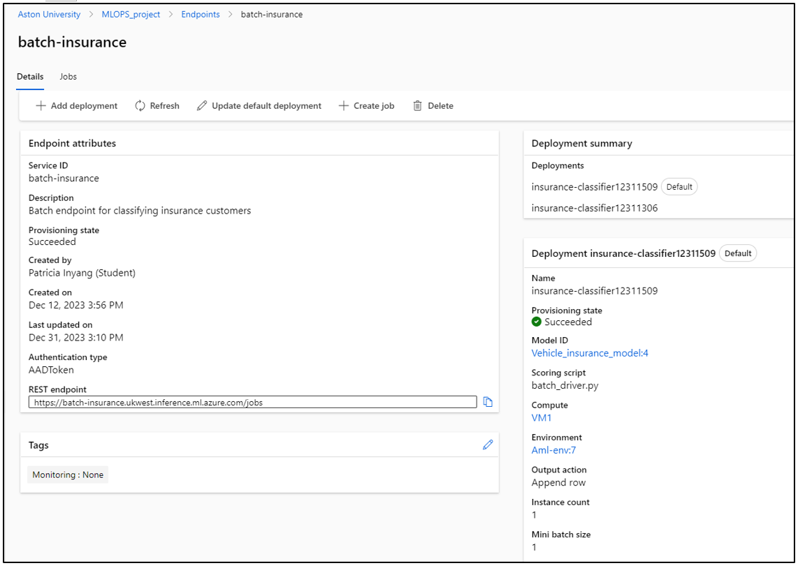
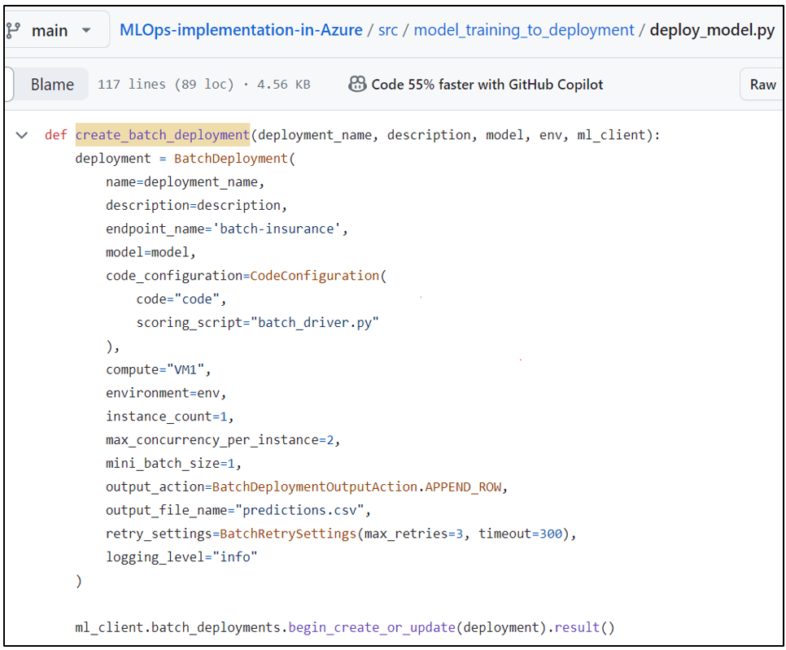
Model Deployment in AML Endpoint

Slide 18
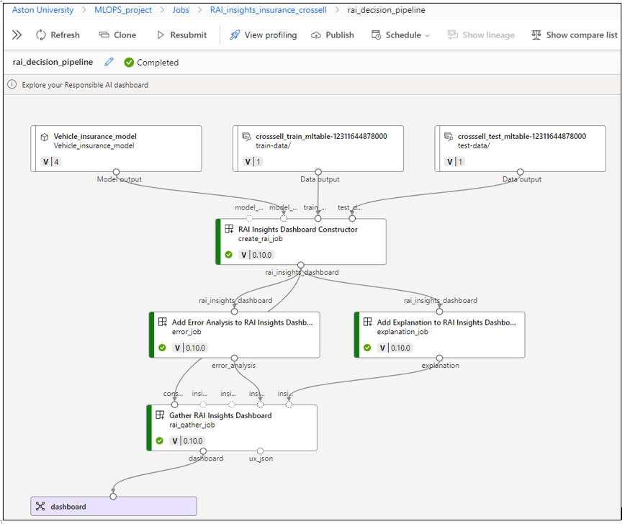
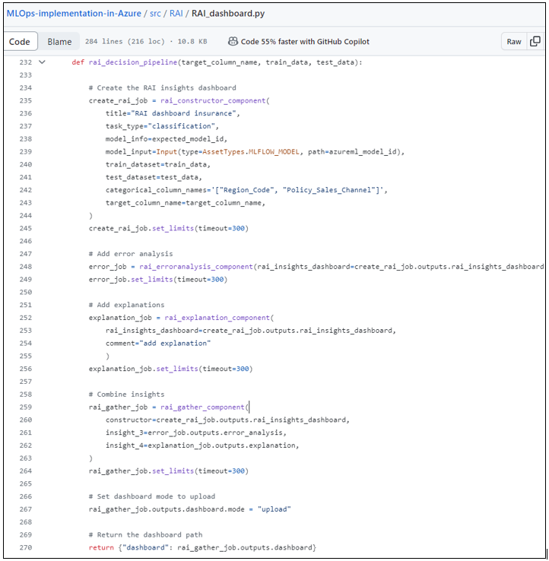
Result from executing the Responsible AI Dashboard Pipeline in AML workspace

Slide 19
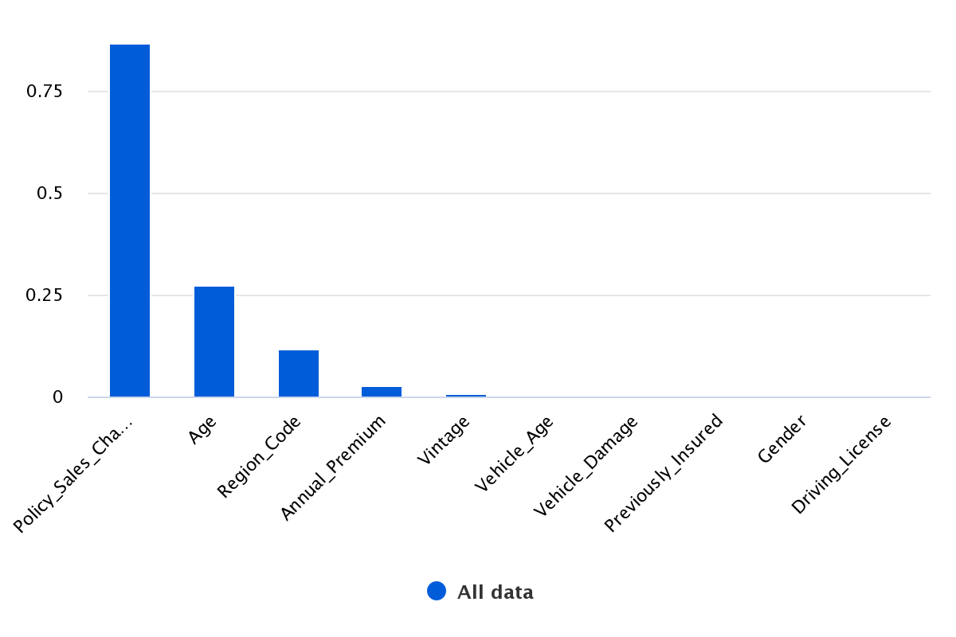
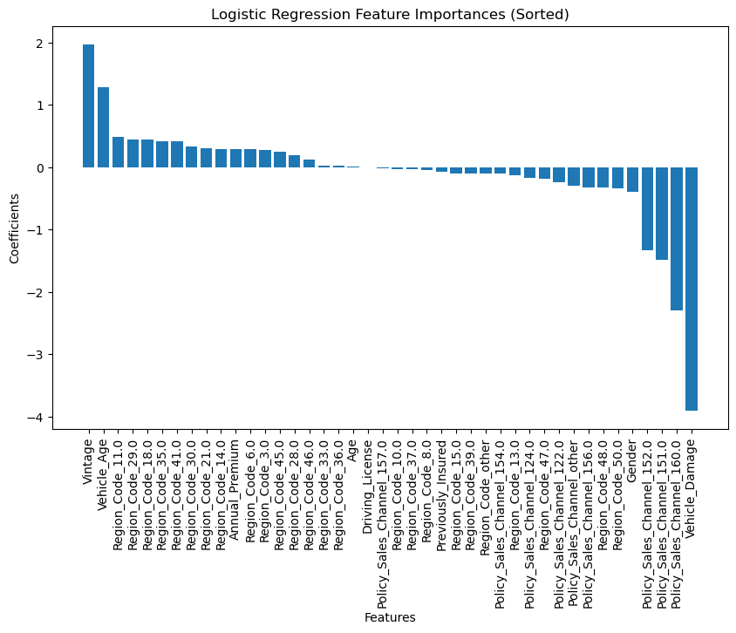
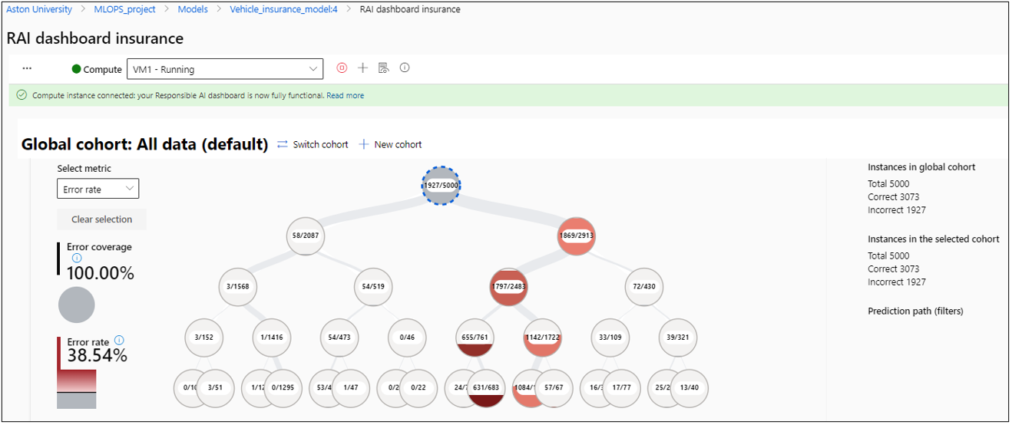
Actual Feature Importance of the Vehicle Insurance model
Insights from the Vehicle Insurance model RAI Dashboard
Model Feature Importance

Slide 20
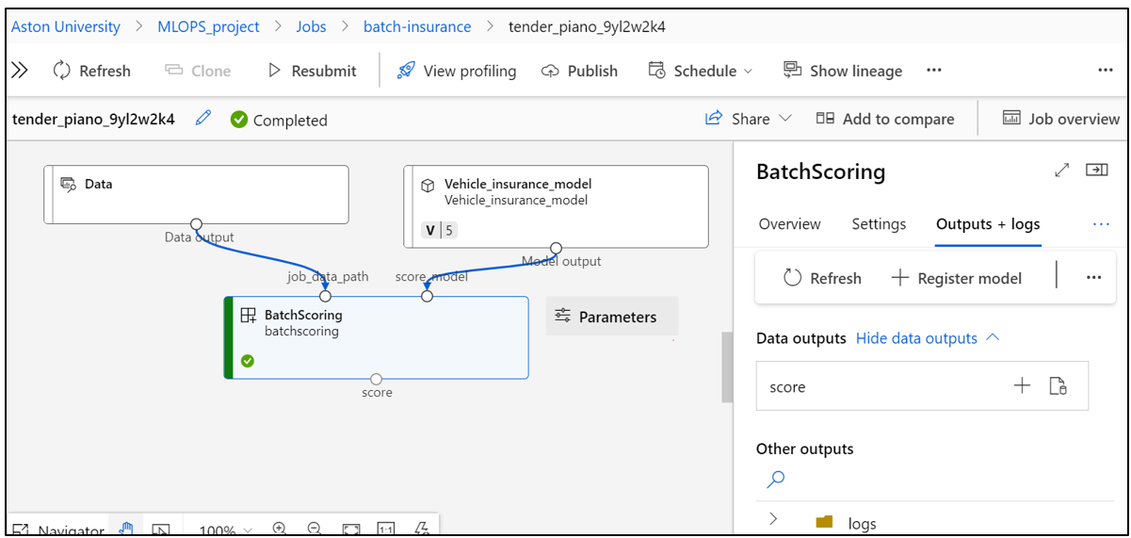
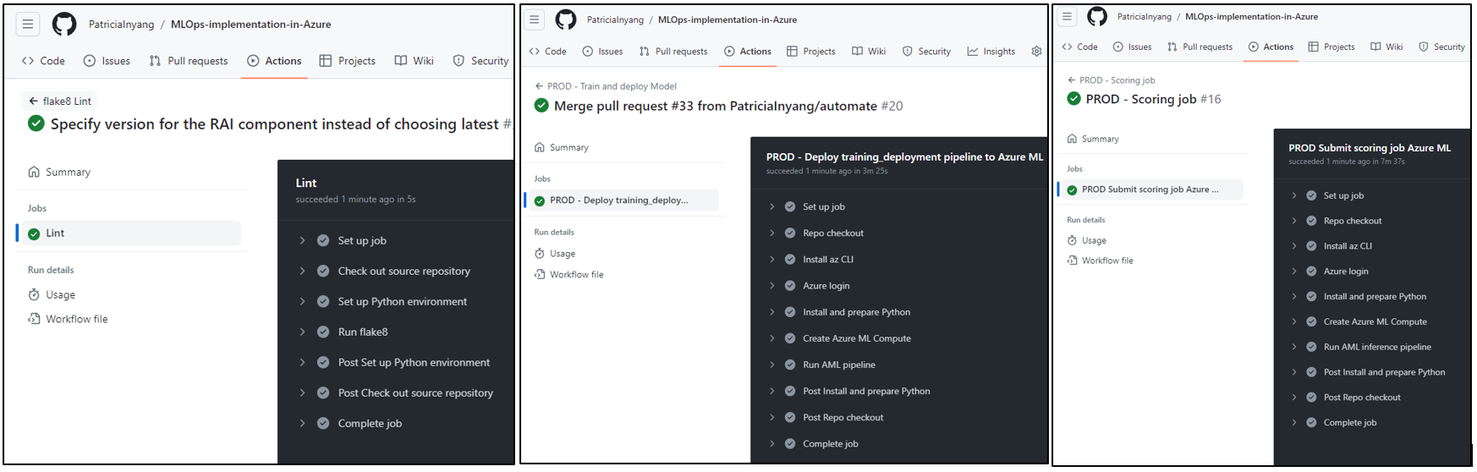
Completed Batch scoring pipeline job
Execution of Automated workflows for CI/CT/CD and Inferencing

Slide 21
Conclusions
Project Limitations
Recommendations
Lessons Learnt
Limited time to achieve full MLOps maturity.
Absence of real-life generated data to continuously operate model in production.
Limited robust testing.
Model performance needs to be optimised.
AML currently allows a maximum of 5000 rows input data for RAI dashboard pipeline.
Explore Azure DevOps and Azure event Grid.
Develop a self-orchestrated Bring Your Own (BYOD) container.
Use of Serverless compute in Azure
Write comprehensive automated tests.
Use continuous delivery pipelines to promote builds through pre-production environment before production.
Improved code quality in line with industry best practices.
I gained proficiency working with tools Visual Studio code, Github, Azure.
Agile practice and cost management when using cloud services.
DevOps is key for accelerating delivery of business value in data science projects.
Maintaining system is crucial to keep it up-to-date with Azure latest roll-outs.
References
https://info.algorithmia.com/hubfs/2019/Whitepapers/The-State-of-Enterprise-ML-2020/Algorithmia_2020_State_of_Enterprise_ML.pdf
Vartak, M. (2023). Achieving Next-Level Value From AI By Focusing On The Operational Side Of Machine Learning. Available at: https://www.forbes.com/sites/forbestechcouncil/achieving-next-level-value-from-ai-by-focusing-on-the-operational-side-of-machine-learning/
https://www.datarobot.com/wp-content/uploads/2023/08/DataRobot_MLOps_101-_The_Foundation_for_Your_AI_Strategy_eBook.pdf
Access the project source code within Kainos private GitHub repository https://github.com/KainosSoftwareLtd/Azure-MLOps-for-Insurance
Access the project source code in Public GitHub repository where the production environment was set up https://github.com/PatriciaInyang/MLOps-implementation-in-Azure

Slide 22

Recommending resources to
help me learn new skills.
“
”
It is a pleasure working
with Kainos Team.
“
”
For your availability in
MS Teams chat and
weekly meetings.
“
”
“
”
For your collaborative support and regular constructive feedback.
The mentorship approach empowered me to be self-driven and take responsibility in sharing ideas.
“
”

Slide 23

Questions & Answers

